Slide 1

(NYSE: RAD)
Current Price: $20.10
Target Price: $26.84
Implied Upside: 33.5%
Dhiya Krupashankar, Krishna Palya, Jason Obrycki, Pulak Taneja, Ian Wu

Slide 2
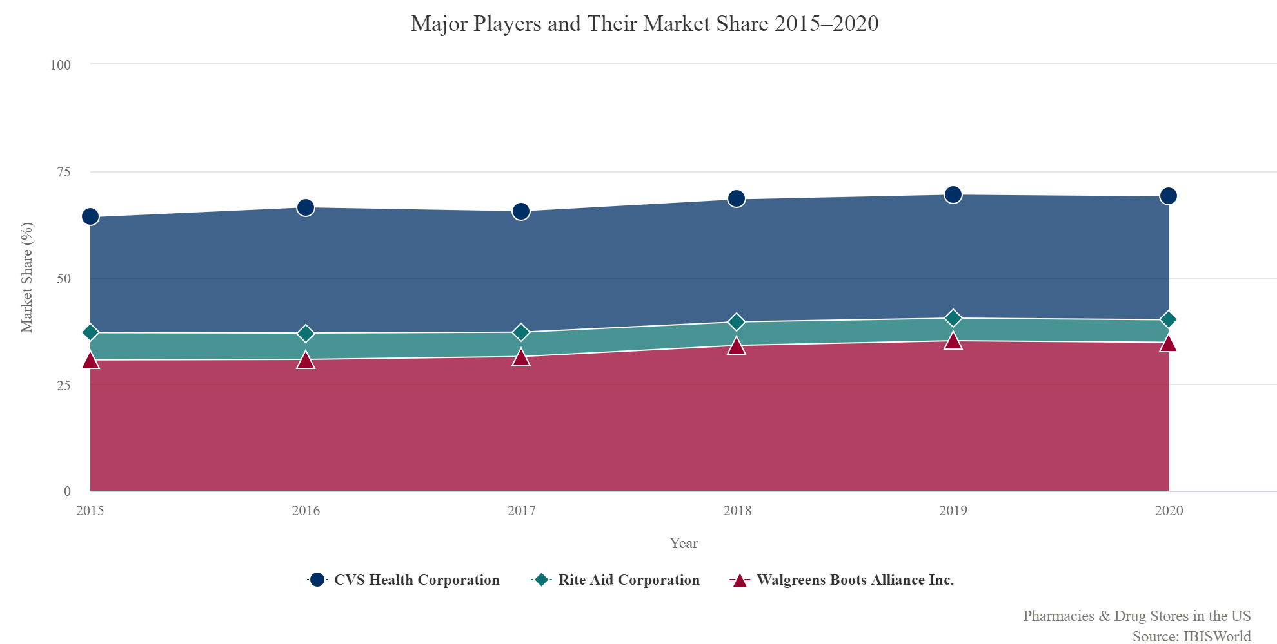
Industry Overview
Pharmacies and Drug Stores in the U.S. are concentrated in terms of functions and companies
Primary Activities - Preparing and selling prescription and non-prescription medicines, advising customers on use of prescription and OTC medicines, other miscellaneous activities (e.g. selling candy cosmetics, magazines etc.)
Major Players - Walgreens Boots Alliance Inc. (34.8% Market Share), CVS Health Corporation (29.1% Market Share), Rite Aid Corporation (5.3% Market Share)
Industry Concentration - Medium-to-high concentration, barriers to entry partially increased by pandemic due to exploitation of economies of scale by major players in the industry
As the rate of vaccinations in the U.S. increases, pharmacies are expected to expand preventive care and additional front-end offerings
Continued easy access to prescription medications due to high proportion of insured individuals and individuals over the age of 65 in the U.S.
Over the five years to 2025, industry revenue is expected to increase an annualized 2.7% to $352.5 billion
The industry is expected to benefit from the economy’s post-pandemic recovery

Slide 3
Company Overview
Core Business
Rite Aid is a pharmacy retail healthcare company, providing services through two business segments, the Retail Pharmacy segment and the Pharmacy Services segment
Retail Pharmacy segment sells brand and generic prescription drugs, as well as front-end products including health and beauty aids, personal care product, and seasonal merchandise
Pharmacy services segment provides PBM (Pharmacy Benefit Manager) services through Envision and MedTrak. Services include operating mail orders, distribution management, and ensuring patient compliance
⅓ of revenue comes from pharmacy services business line and ⅔ comes from food
Wellness+ Rewards Program
National Network
Over 13 million Wellness+Rewards loyalty program members
Over 60% of customer transactions at Rite Aid now include a Wellness+ Rewards card
Program recently relaunched with advancements including BonusCash, enhanced personalization through machine learning, mobile app integration, and 24/7 exclusive access to a pharmacist
Members reach tiers based on points accumulated throughout the calendar year, with the “Gold” tier enabling a 20% discount on front-end merchandise
Third largest retail drugstore chain in the United States based on both revenues and number of stores.
Operates 2,469 stores in 18 states across the country
58% of the stores are freestanding, 54% include a drive-thru pharmacy, 62% include a GNC store within a Rite-Aid store
Immunizations program has been a key focus with a record 3.4 million immunizations in 2020
Entered a termination agreement in August, 2018 -- decided to stay a standalone company
Company
Industry
Thesis
Valuation
Risks

Slide 4
Activist Opportunity
Context & Proposal
Rite Aid has been consistently undervalued compared to competitors such as Walgreens and CVS
Rite Aid owns Elixir, a PBM service, currently generating $8 billion in annual revenues
Previously had failed merger with Walgreens and sold 1,923 stores for $4.4 billion
Currently have $3.2 billion in debt and every quarter, interest expense is slightly over $50 million
Rite Aid could demonstrate its value by selling its remaining stores and focus on Elixir PBM
Sale of Stores
Elixir
Sold stores at a price of $2.275 million per
Using conservative number of $1.8 million, Rite Aid could sell its remaining 2,450 locations and brand name for $4.4 billion
Pays off $3.2 billion in debt and retains $1.2 billion in cash on hand
Reported a year-over-year growth rate of 23-29% for each of its last 4 quarters
Elixir has a $200 million projected EBITDA for 2022 assuming no growth at all
With only 55 million shares outstanding, a low PE multiple, and $1.2 billion, Elixir is well positioned for acquisitions or organic growth
Company
Industry
Thesis
Valuation
Risks

Slide 5
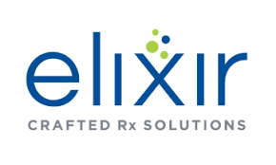

Opportunity in the PBM Industry
Overview
The Acquisition of EnvisionRX
PBM → Pharmacy Benefit Manager
In the US, a pharmacy benefit manager is a third- party administrator of prescription drugs, managing plans on behalf of health insurers
Rite Aid has positioned itself to be a key player in the mid- market PBM industry
Mid-market PBM Industry → $400B Market
2015: Rite Aid acquires EnvisionRX
2020: EnvisionRX integrates its pharmacy benefits and service and technology companies, rebranding with the name Elixir
In Q4 of 2020, Rite Aid announced a mass rebranding of its stores and a shift in marketing strategy, which includes heavily investing into Elixir’s pharmacy solutions
PBM- Centered Approach
Biggest competitors in PBM: Express Scripts, Caremark, OptumRX (“The Big Three”)
EnvisionRX is entering a market with little to no penetration by the big three: The mid- market PBM industry
Revenues rose 11% and pharmacy- services segment sales jumped 29% as Elixir was launched and market share improved
Company
Industry
Thesis
Valuation
Risks
Notes:
https://www.forbes.com/sites/brucejapsen/2020/09/24/rite-aid-ceo-store-and-pbm-rebrand-well-underway/?sh=1f418a8169d1
https://www.businesswire.com/news/home/20200319005450/en/More-Efficiency-Service-and-Value-on-the-Horizon-as-EnvisionRxOptions-Integrates-Its-Family-of-Brands-as-Elixir

Slide 6
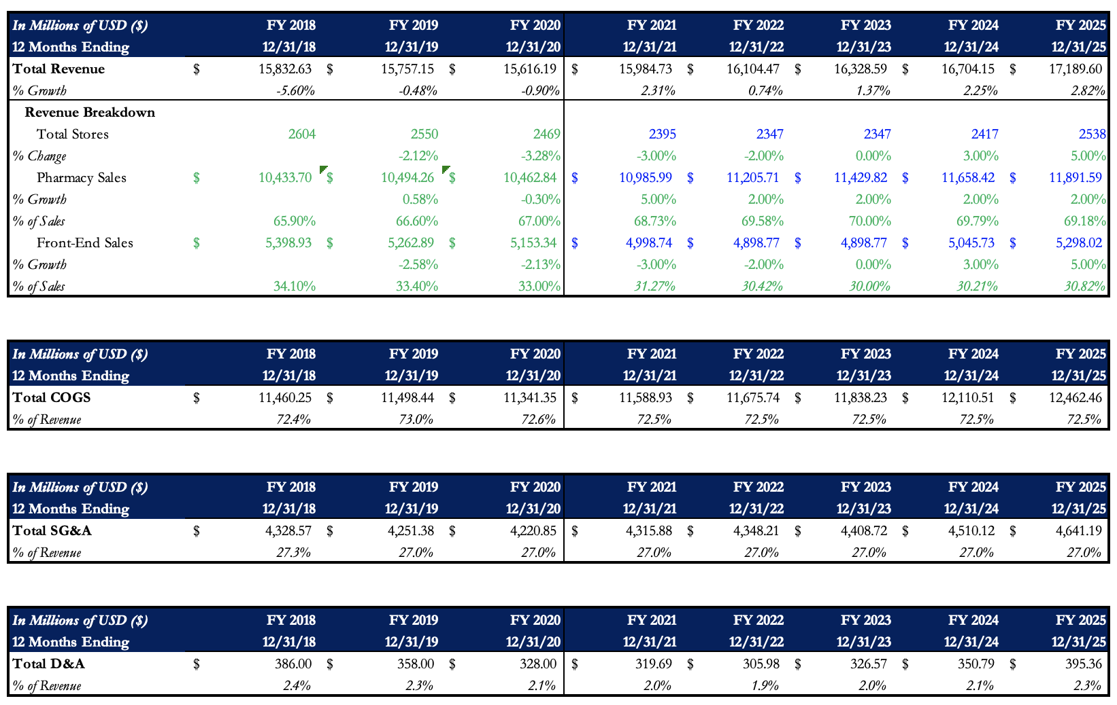
Valuation – Revenue Build
Company
Industry
Thesis
Valuation
Risks

Slide 7
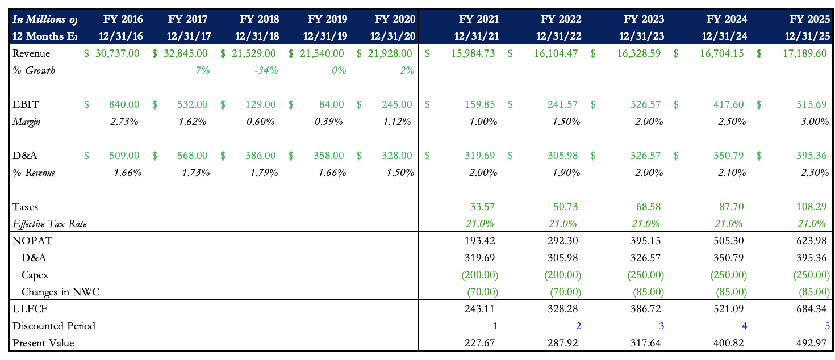
Valuation – DCF
Company
Industry
Thesis
Valuation
Risks

Slide 8
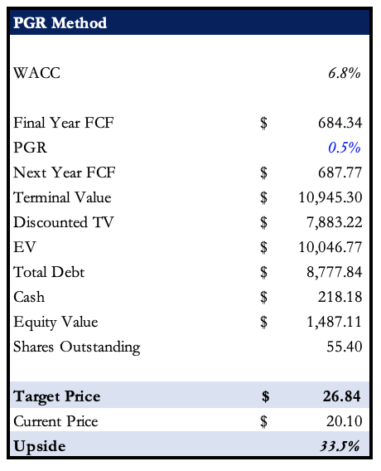
Valuation – PGR & Upside
Company
Industry
Thesis
Valuation
Risks

Slide 9
Risks & Mitigants
Potential for price war to get into preferred pharmacy networks due to lack of scale compared to chains like Walgreens and CVS who have better preferred networks
New management is trying to expand Rite Aid into greater preferred pharmacy networks and the PBM segment already grew revenues by 3.3% in 2019 through Medicare D network expansion.
Slow pace of post-pandemic recovery could reduce the rate at which greater preventive care offerings are made available to the public
The pandemic, coupled with Rite-Aid’s large size vis-a-vis competitors, enables them to leverage and capitalize on greater economies of scale
Company
Industry
Thesis
Valuation
Risks

